Slide 1
Hacking on Azure Websites
with Node.js and the Spotify Web API
@DanielLarsenNZ

Slide 2
This talk
Node.js on Azure Websites
Spotify Web API
Node.js + Express, Table Storage
WebJobs, Queue Storage

Slide 3


http://hackakl.org.nz/
Notes:
Hacking is: “The act of engaging in programming in a spirit of playfulness and exploration.
Hacker is: “A person who enjoys exploring the details of programmable systems and stretching their capabilities.
“Hacking entails some form of excellence, for example exploring the limits of what is possible, thereby doing something exciting and meaningful.

Slide 4
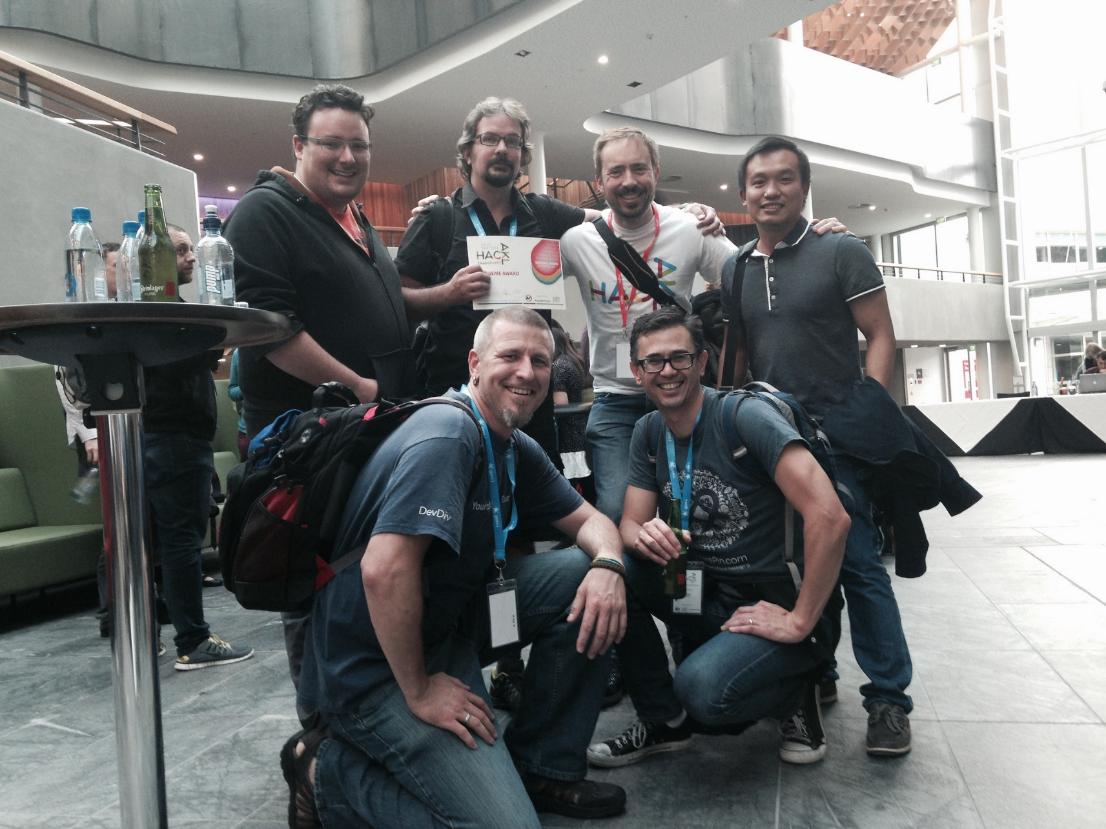

Slide 5
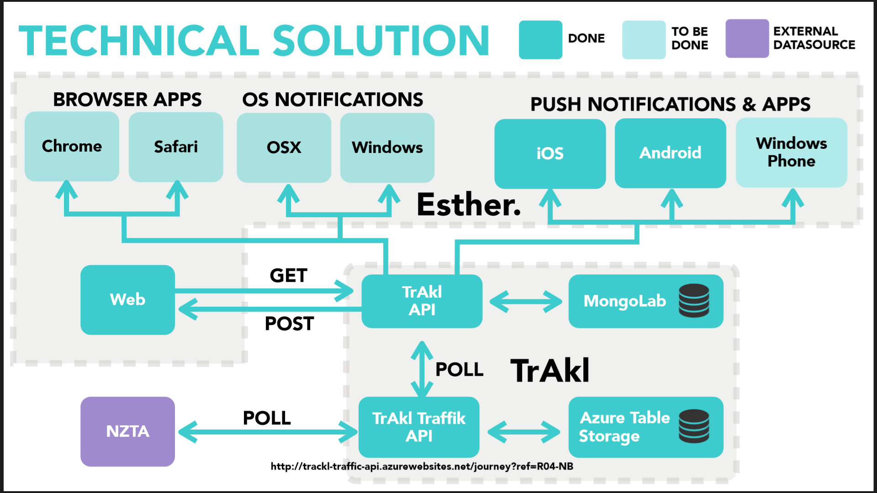

Slide 6

Azure Websites
Node.js
Express
Sails.js
Waterline
MongoDB
Angularjs
Ionic
Mobile Angular
PureCSS

Slide 7
Node.js on Azure Websites
Azure Website Instance
IIS
iisnode
Node.exe
JS
Packages
Notes:
Node.js is a platform, or a runtime environment.

Slide 8
Node.js in Visual Studio
Visual Studio 2015 Preview
Visual Studio 2013 Update 4
All editions including Express!
Visual Studio 2012 Update 4
Pro edition +
Web Essentials (optional)
Node Tools for Visual Studio (NTVS) 1.0 beta 3

Slide 9
Demo
Node.js + NTVS + Azure Websites

Slide 10
Spotify Web API
https://developer.spotify.com

Slide 11
Demos
https://developer.spotify.com/web-api/
http://music.xbox.com/Developer
http://lab.possan.se/thirtify

Slide 12
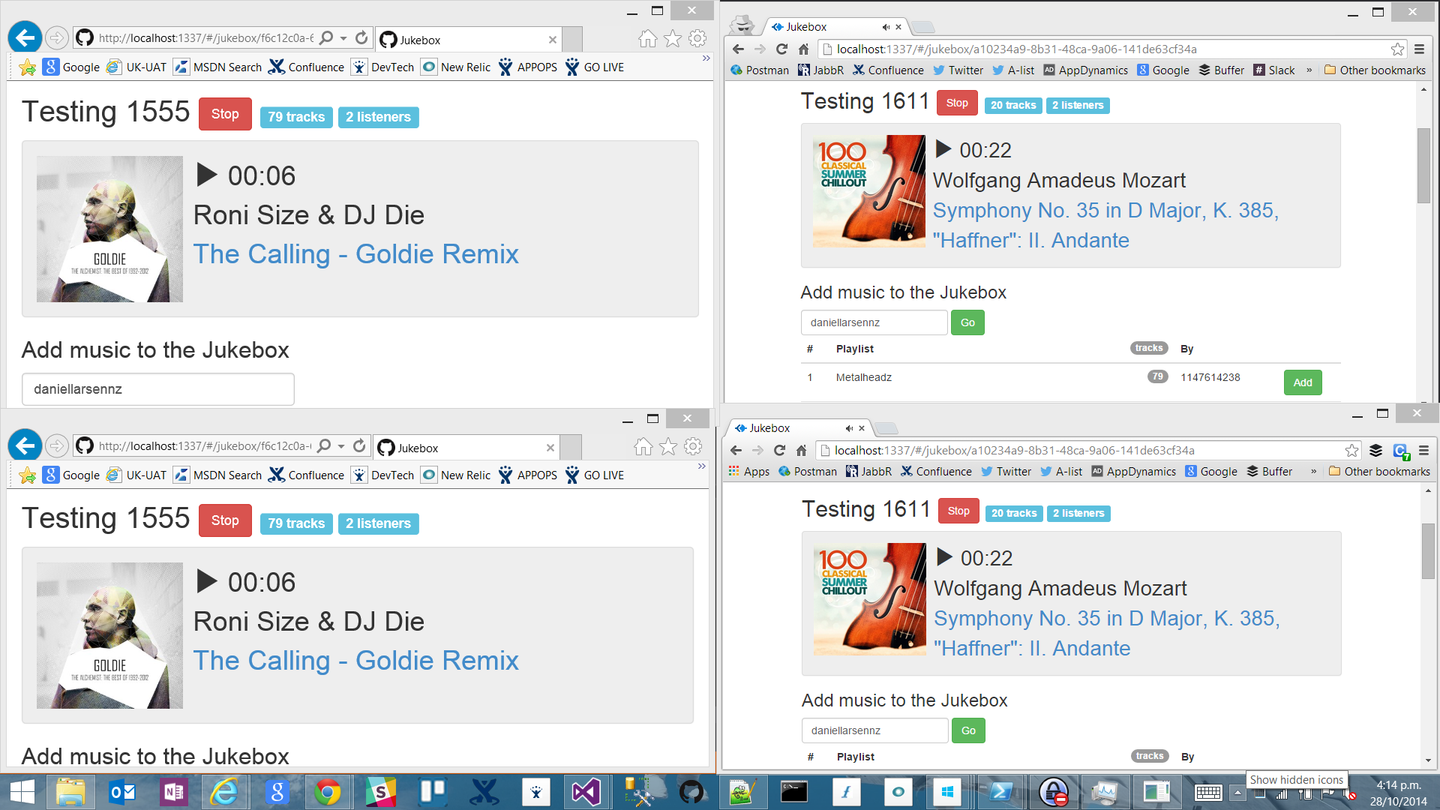
http://jukebox30.azurewebsites.net

Slide 13
Architecture
Browser
Azure Website
Azure Storage
Bootstrap
Queue Storage
Angular.js
express
socket.io
socket.io
Table Storage
Node.js
iisnode
Edge.js
WebJobs
Spotify Web API

Slide 14
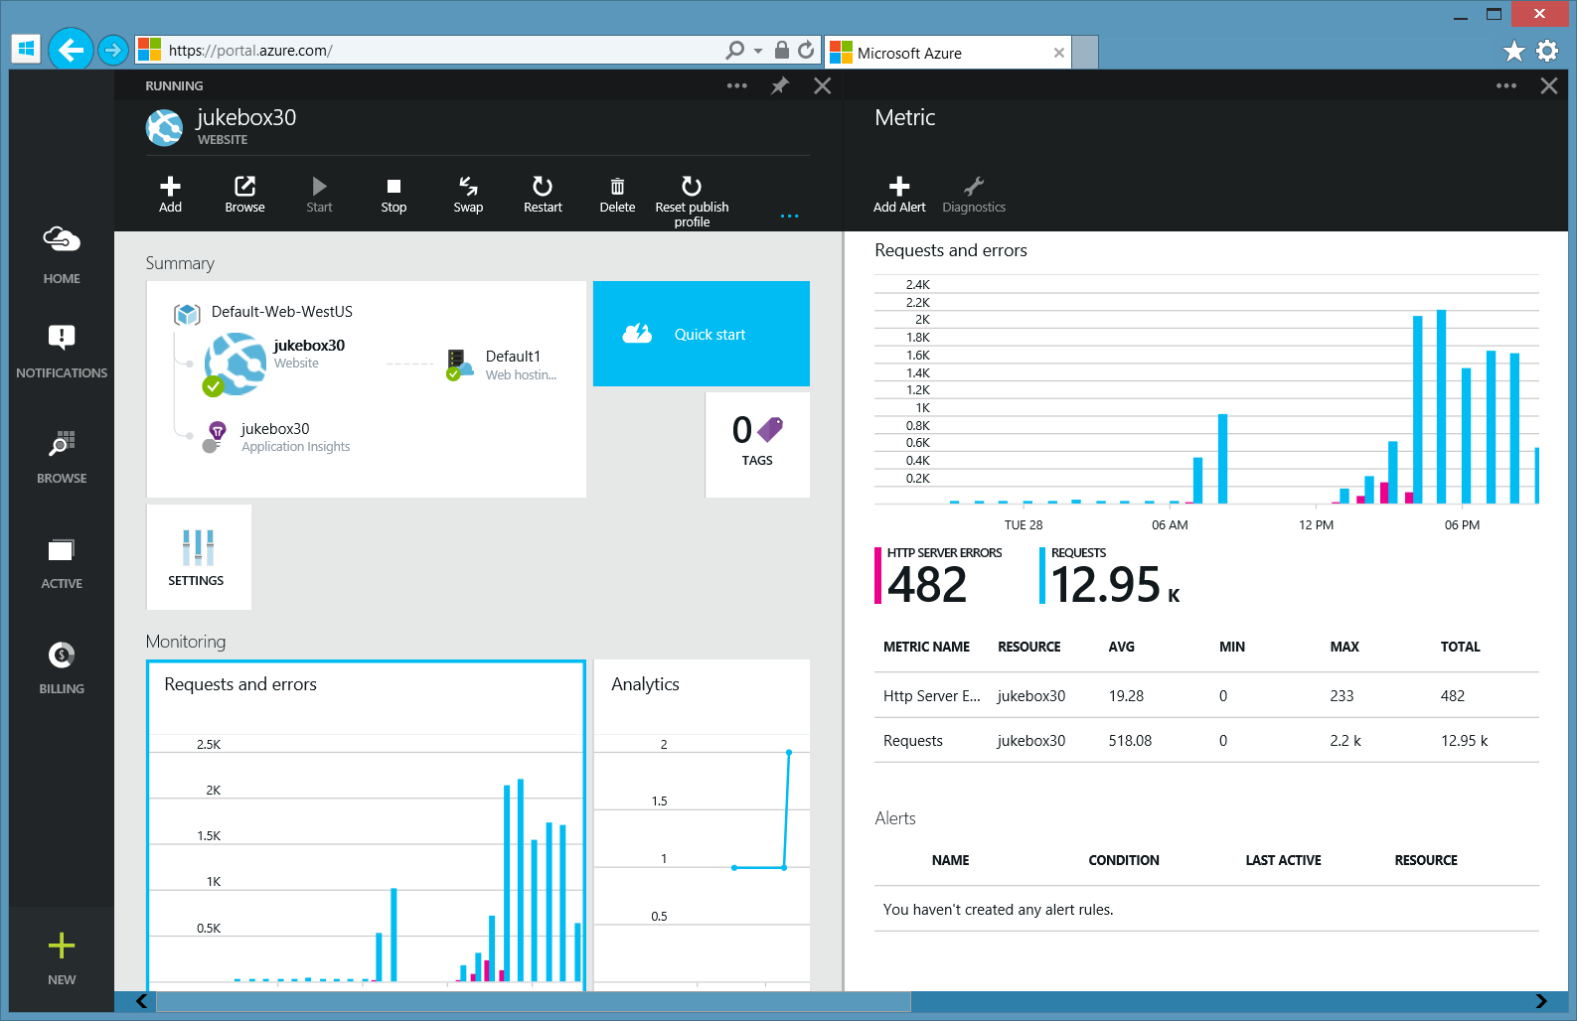
(The new) Azure Portal
Streaming logs
Monaco
…

Slide 15
Invoking C# code from Node.js with Edge.js

Slide 16
Inception
Azure Website Instance
IIS
iisnode
Node.exe
JavaScript
Edge.js
C#
Notes:
Node.js is a platform, or a runtime environment.

Slide 17
Sync pattern
UI Request waits… 1,300ms
API
Spotify API
Node.js
Table Storage
C# DLL

Slide 18
Queue pattern
API
Message Queue
Node.js + express
Enqueue
Queue Storage
Quick Response
300ms
Dequeue
Table Storage
WebJob
C# EXE
Spotify API

Slide 19
Azure Queue Storage, WebJobs

Slide 20
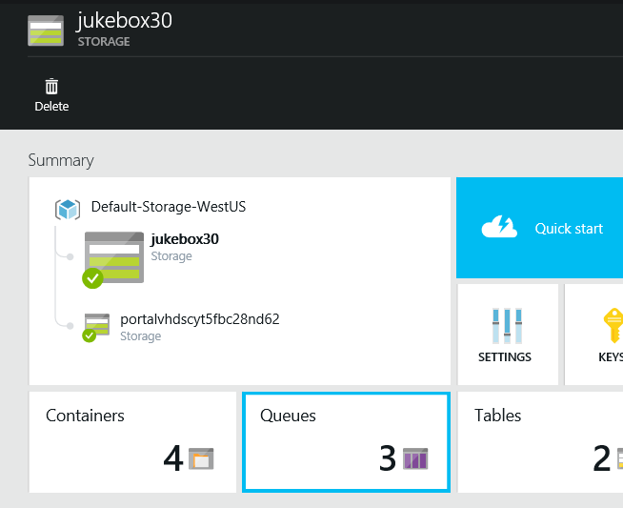
Azure Queue Storage
Simple, affordable Message Queue with geo-redundancy that massively scales.
Notes:
Simple REST API. Libraries for Node.js, .NET...
String message up to 64KB. Practically unlimited Queue size
Geo/Zone/Local redundancy. Cheap
Consider Azure ServiceBus if you need Instant Notification, Guaranteed Delivery, FIFO, etc.

Slide 21
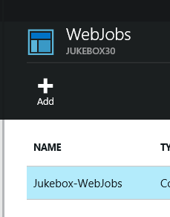
WebJobs SDK
Simple cron / AT / “Scheduled Task” style jobs that are perfect for background processing Storage operations.
Notes:
Simple jobs that can run continuously or to a schedule. Jobs can be EXEs, .JS and more.
Can run in same Azure Website as App or in a standalone Azure Website.
WebJobs SDK is a .NET library that simplifies Queue polling, poison message handling, Blob updates, etc.

Slide 22
Azure WebJobs, Queue Storage
Walkthrough

Slide 23
Recapping
Node.js on Azure Websites
Spotify Web API
Node.js + Express, Table Storage
WebJobs, Queue Storage

Slide 24
Questions?
Daniel Larsen
@DanielLarsenNZ
https://github.com/DanielLarsenNZ/Hacking-on-Azure

Slide 25
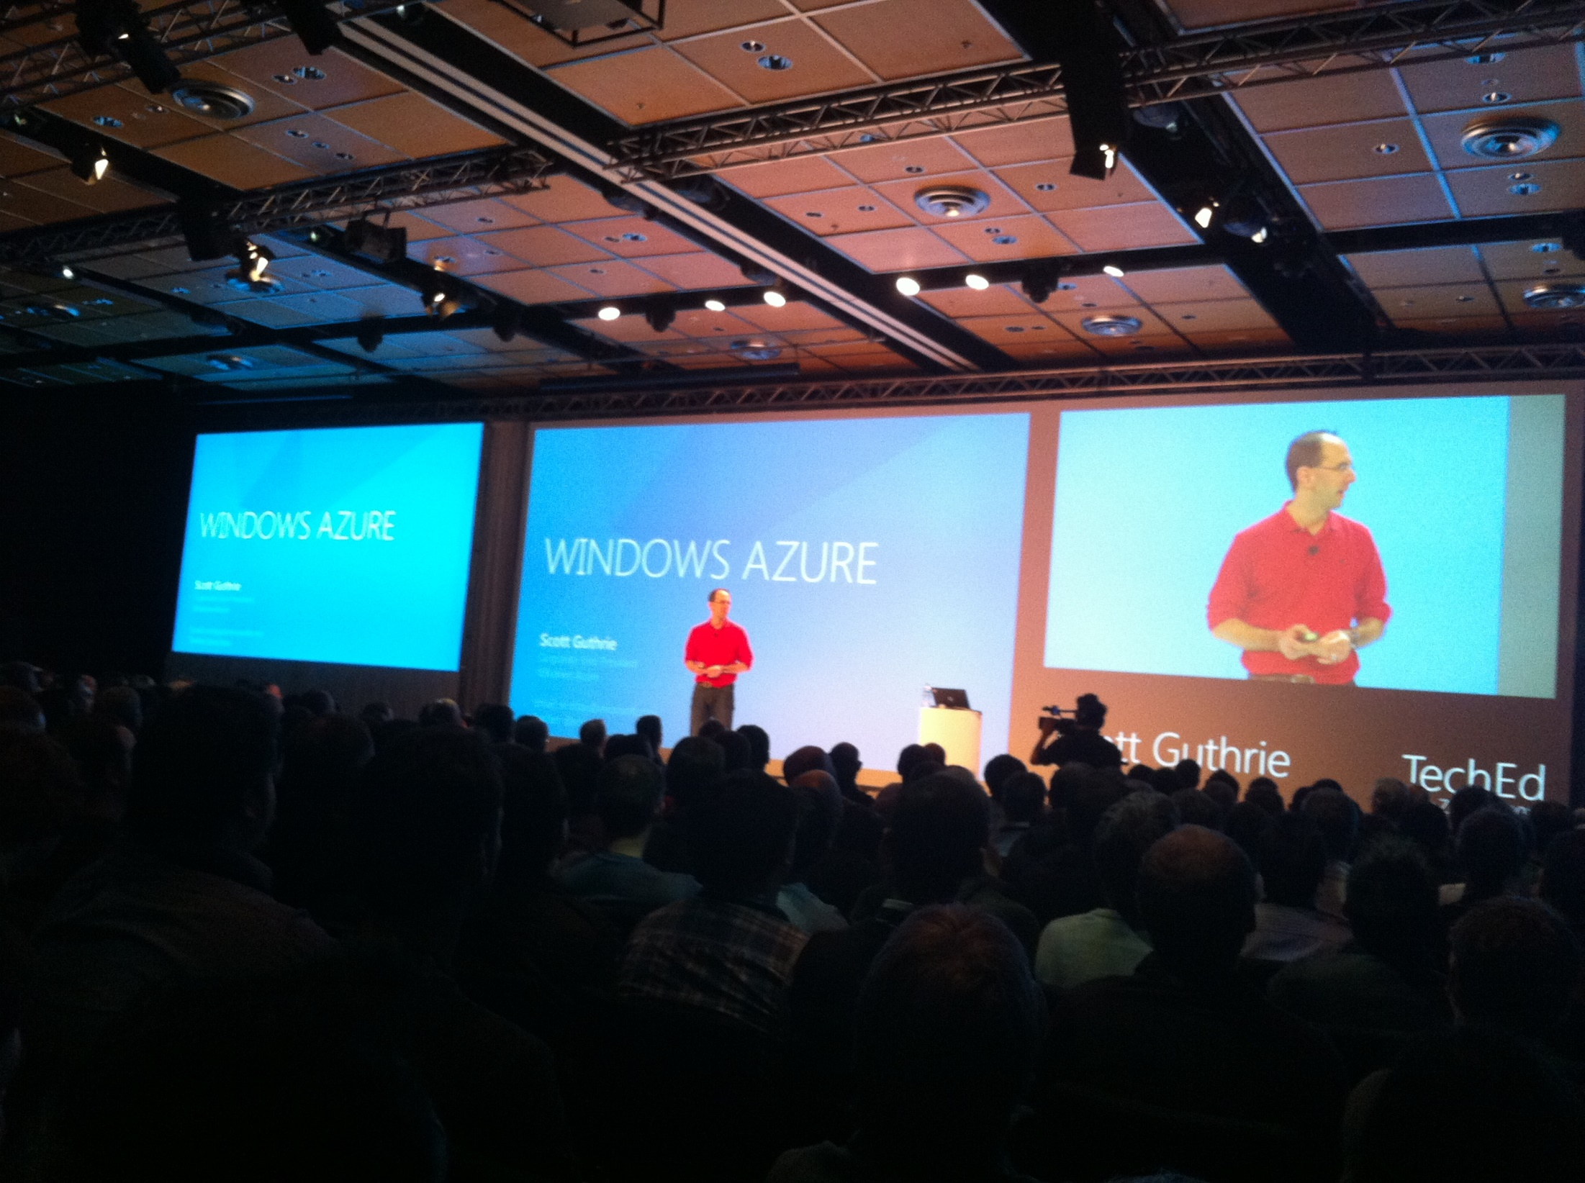

Slide 26
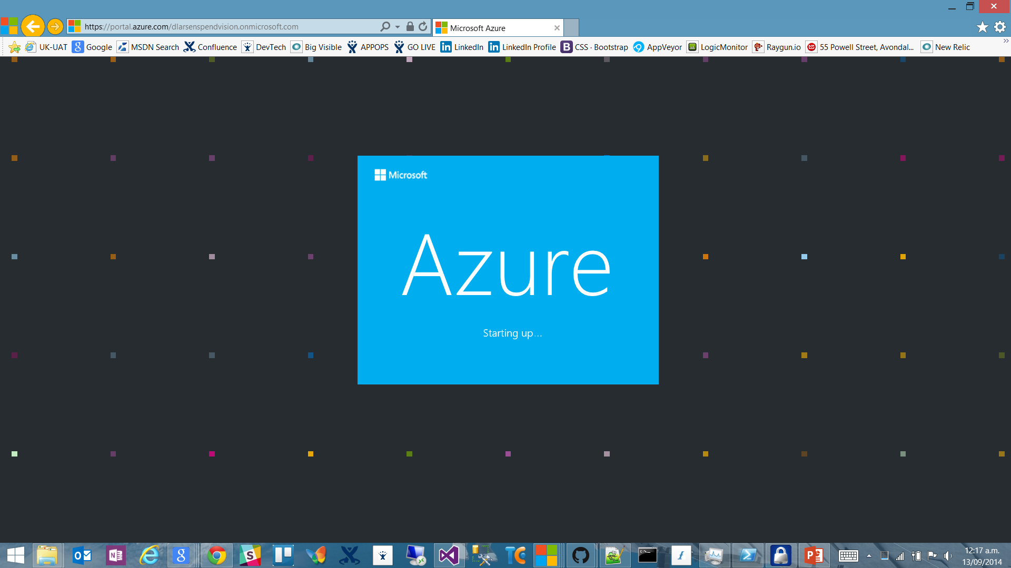

Slide 27
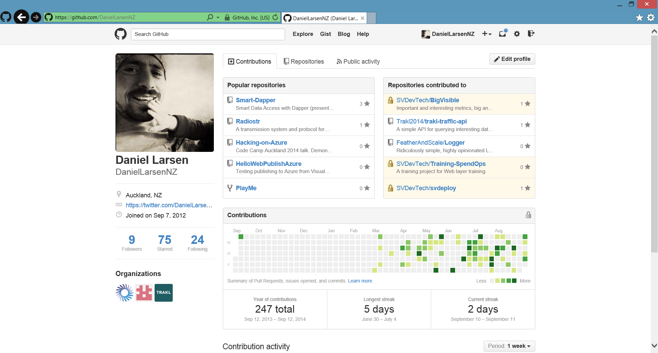

Slide 28
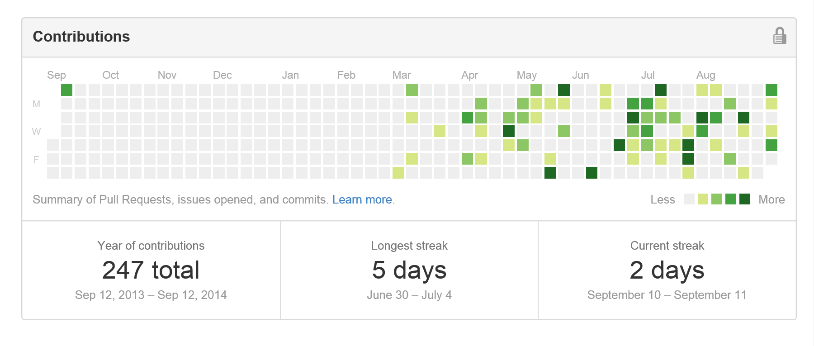
Contribution addiction

Slide 29
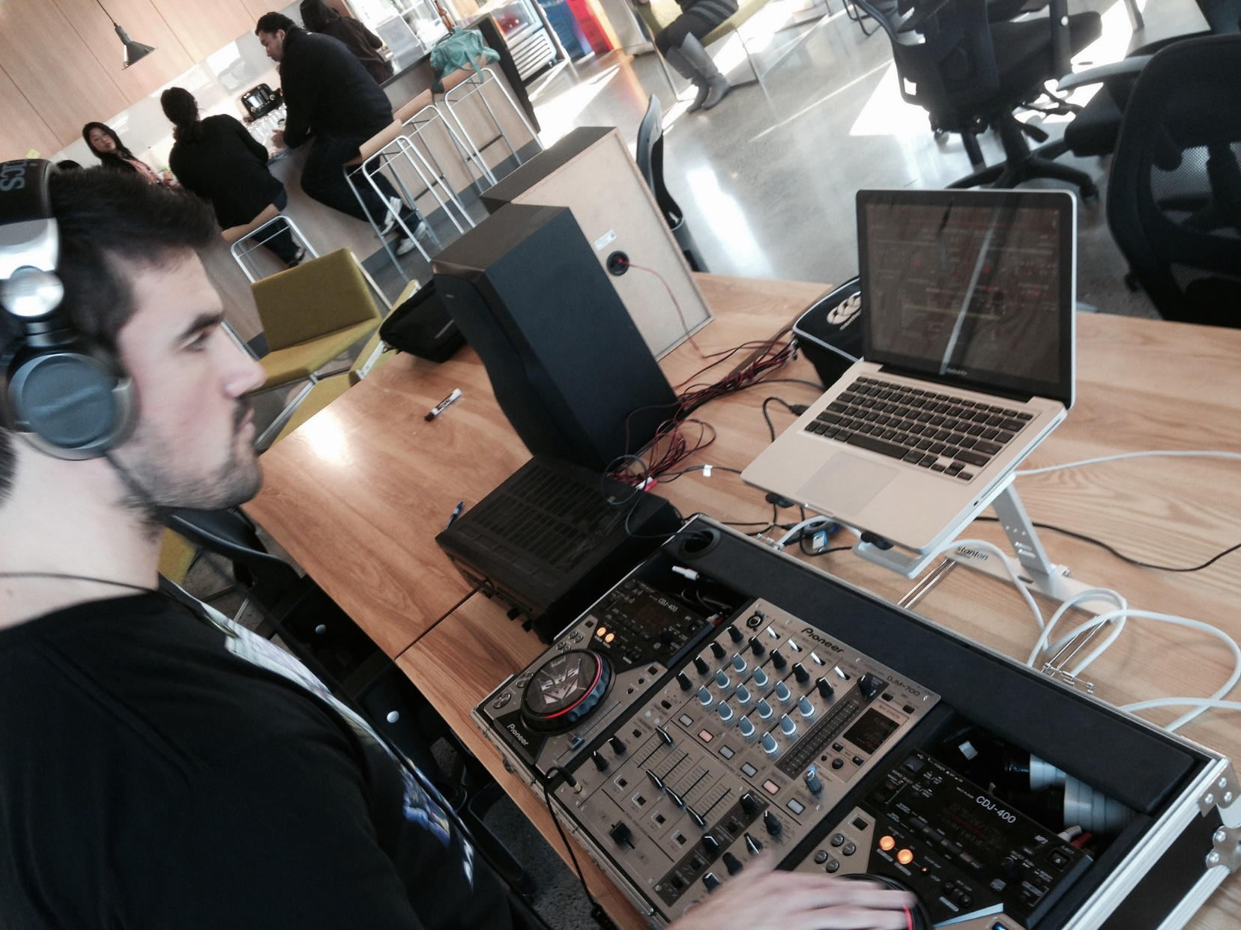

Slide 30

http://en.memory-alpha.org/wiki/Phoenix

Slide 31

By NASA [Public domain], via Wikimedia Commons http://commons.wikimedia.org/wiki/File%3AApollo_11_Earth.jpg

Slide 32
Hacking
(This is not a Security talk)

Slide 33
Hacking is exploration
“The act of engaging in programming in a spirit of playfulness and exploration.
http://en.wikipedia.org/wiki/Hacker_(programmer_subculture)

Slide 34
Hacker enjoys exploring
“A person who enjoys exploring the details of programmable systems and stretching their capabilities.
http://en.wikipedia.org/wiki/Hacker_(programmer_subculture)

Slide 35
What is possible?
“Hacking entails some form of excellence, for example exploring the limits of what is possible, thereby doing something exciting and meaningful.
http://en.wikipedia.org/wiki/Hacker_(programmer_subculture)

Slide 36
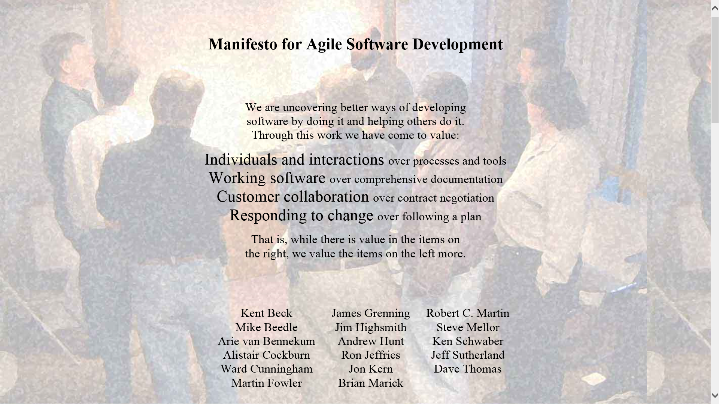

Slide 37
Architecture phase 1
Browser client (Angular.js)
Azure Website
(Node.js)
Spotify Web API
Queue Storage

Slide 38
What I didn’t talk about
New Relic
Newman
GitHub deploy
Kudu
Edge.js
CoreCLR, OWIN, Density
Azure costs
Visual Studio Monaco
Lean

Slide 40


Slide 41
http://en.memory-alpha.org/wiki/Phoenix

Slide 42
By NASA [Public domain], via Wikimedia Commons http://commons.wikimedia.org/wiki/File%3AApollo_11_Earth.jpg

